Slide 1
Capstone Project
Java Selenium Batch - 4
Name : Ankala Naga Swapna
Superset ID : 4867531

Slide 2
Automation-Money Control

Slide 3
CONTENTS
Project Overview | 4
Project Structure | 5
Feature Files | 6
Runner Class | 8
Step Definitions POM Class Utility Class | 8 9 10
Hooks Class | 10
Configurations | 10
Extent Reports | 11
Project Config & Build Mngt | 13
Console Output GIT Screenshots | 14 15 16

Slide 4

OVERVIEW OF PROJECT
ADD COMPANY NAME
Capstone Automation – Money Control
This project is an automation testing framework designed for validating financial calculators (like PF, Gratuity, Car Loan, and Personal Loan) available on the Money Control website. It follows BDD (Behaviour Driven Development) with Cucumber + TestNG + Selenium WebDriver and uses the Page Object Model (POM) approach.
🔗https://github.com/Swapnaankala/Capstone-Automation-MoneyControl_Project

Slide 5
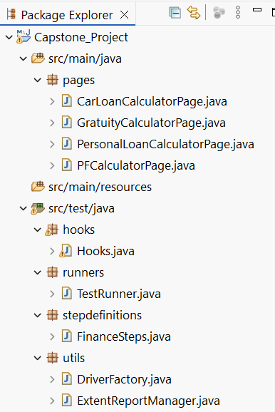
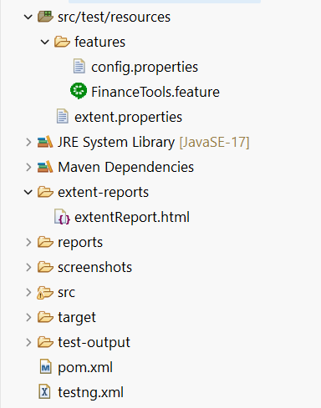
PROJECT STRUCTURE

Slide 6
FEATURE FILES
1. PF Calculator
2. Car Loan Calculator
3. Personal Loan Calculator
4. Gratuity Fund Calculator

Slide 7
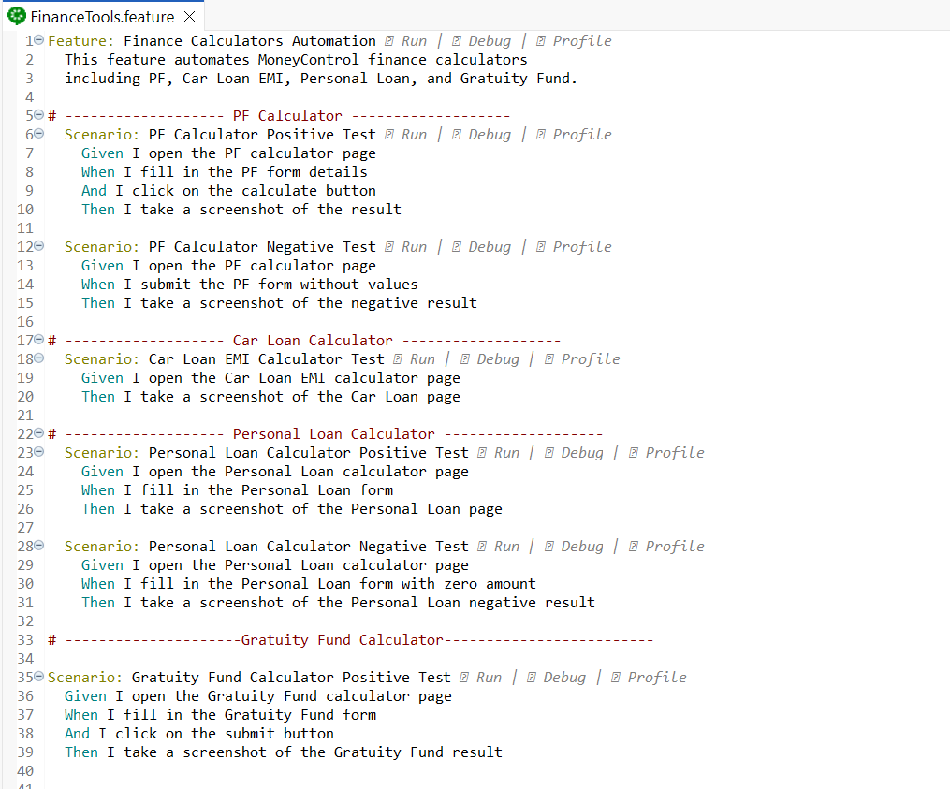
FEATURE FILES-STRUCTURE

Slide 8
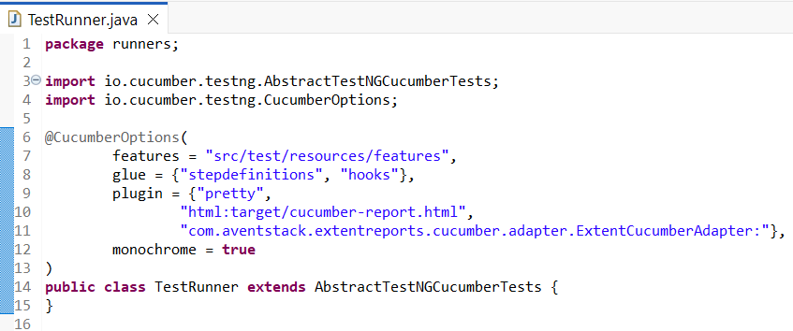
RUNNER CLASS
The runner class executes all feature files, integrates Cucumber with TestNG, and generates automation reports.
TestRunner.java
Cucumber TestNG runner class. Executes feature files using Cucumber options (features, glue, plugin for reports).
Step Definitions
FinanceSteps.java
Step definition methods that map Gherkin steps from .feature files to java code(calls methods from page classes).

Slide 9
Page Object Model (POM) class
ADD COMPANY NAME
These contain Page Object Model (POM) classes for different financial calculators. Each class will have web element locators and methods that interact with those elements.
CarLoanCalculatorPage.java
Defines locators & methods for car loan calculator page (e.g., loan amount, tenure, interest rate, EMI calculation).
GratuityCalculatorPage.java
Handles gratuity calculator (e.g., last drawn salary, years of service, gratuity payable).
PersonalLoanCalculatorPage.java
Contains elements and actions for personal loan calculations (loan amount, tenure, EMI).
PFCalculatorPage.java
Page class for provident fund calculator (basic salary, employer contribution, total PF amount).

Slide 10
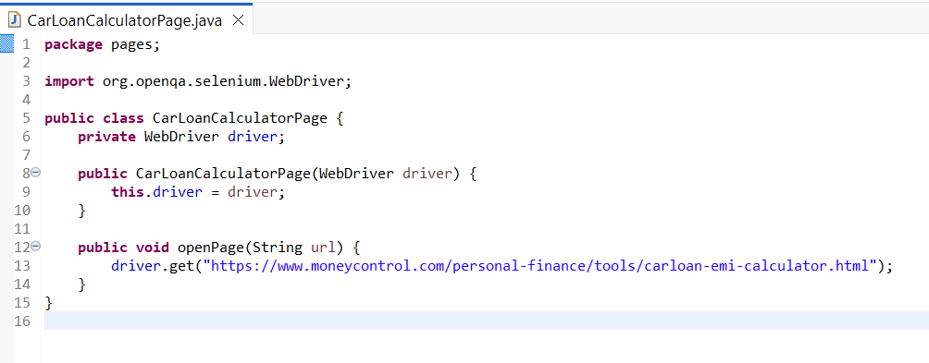
CarLoanCalculatorPage.java

Slide 11
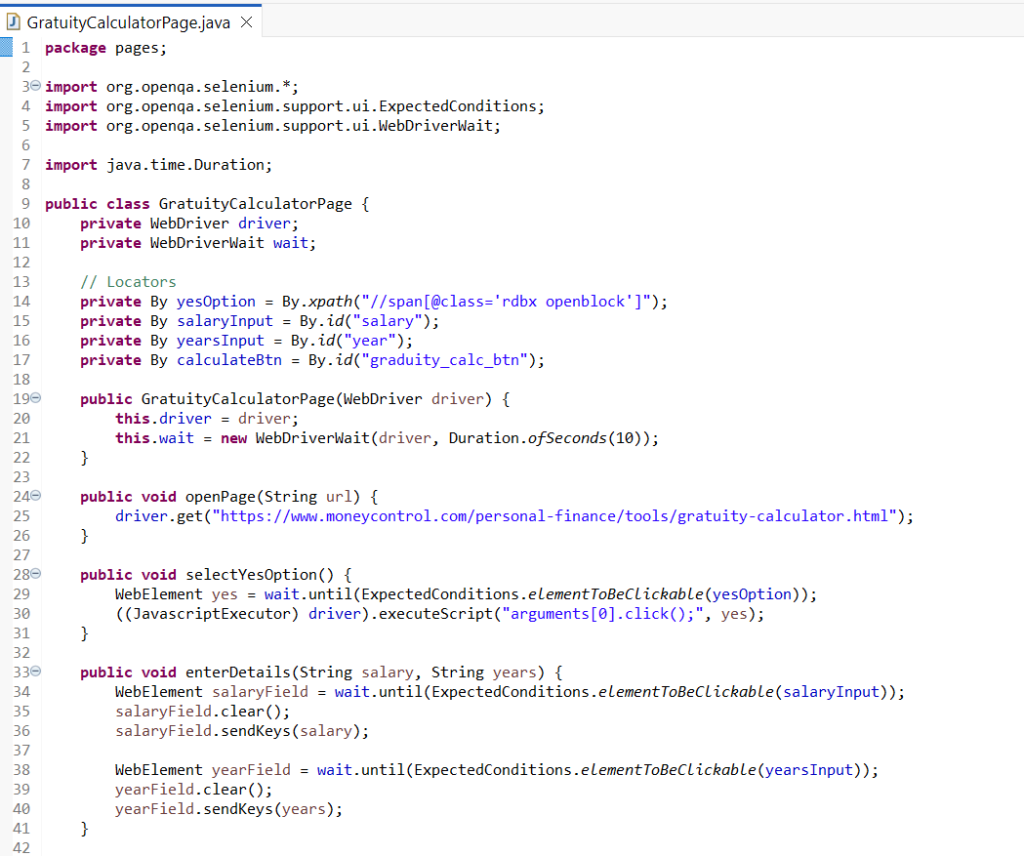
GratuityCalculatorPage.java

Slide 12
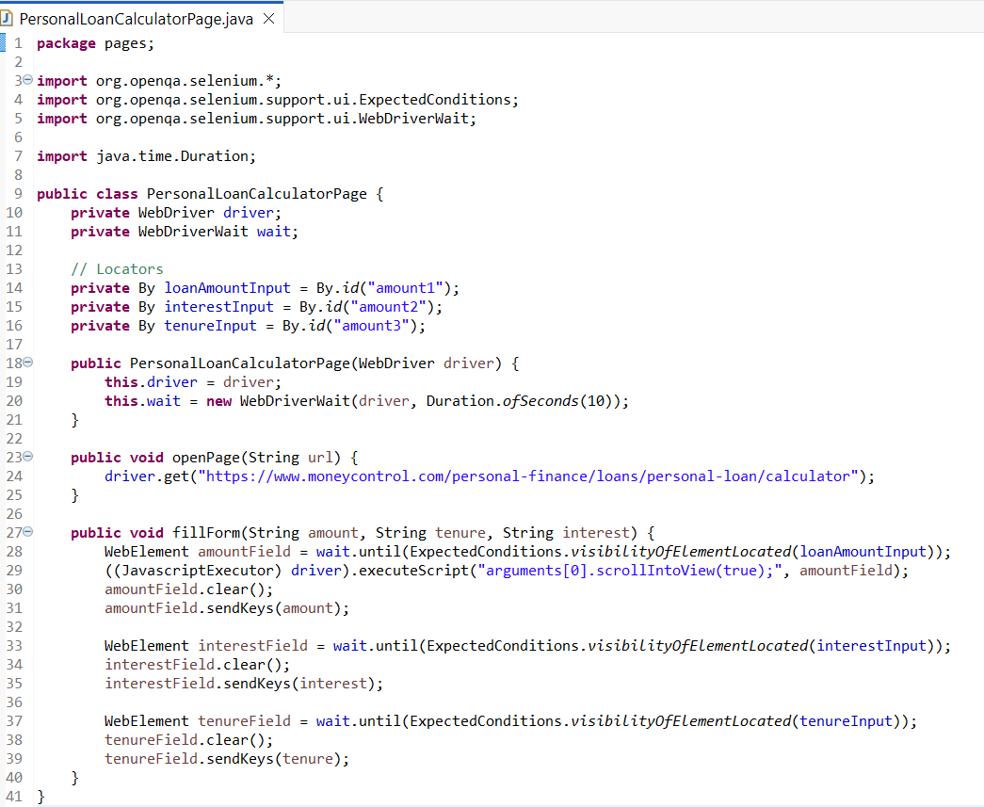
PersonalLoanCalculatorPage.java

Slide 13
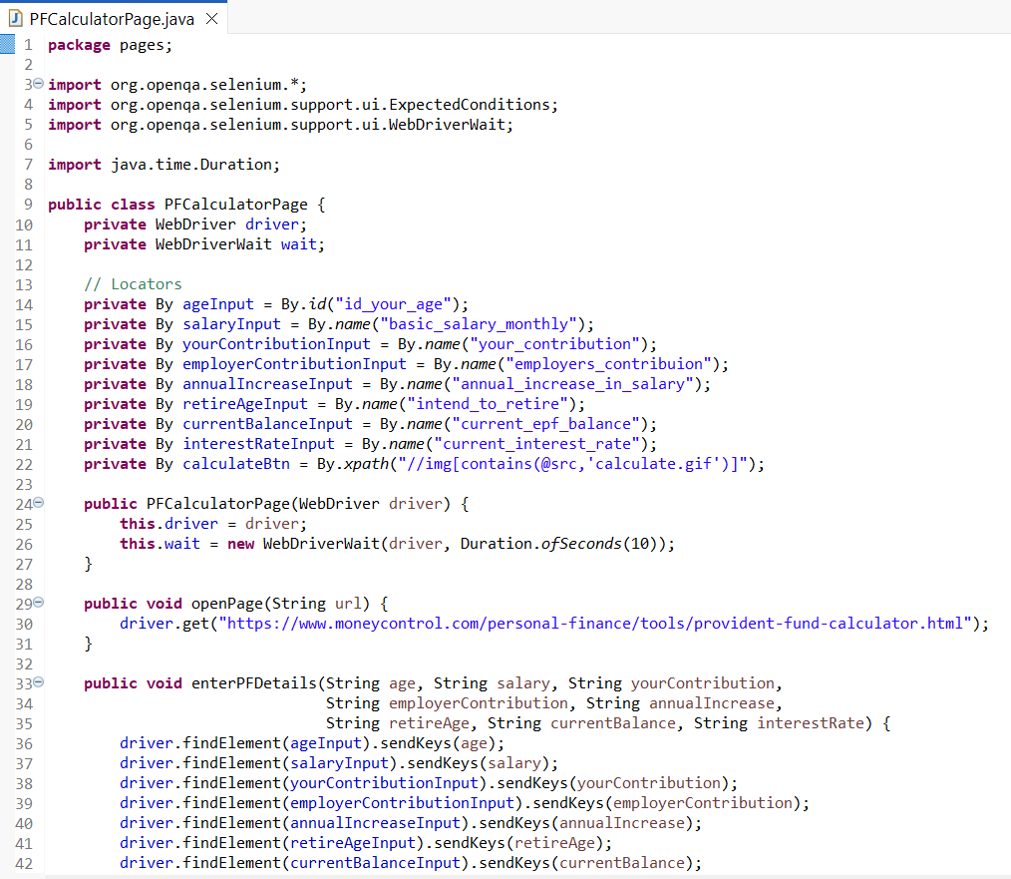
PFCalculatorPage.java

Slide 14
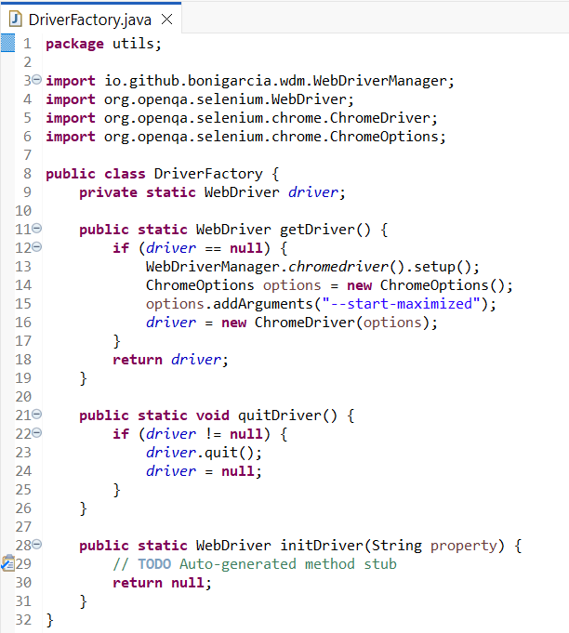
Util
DriverFactory.java
Manages WebDriver initialization (Chrome, Firefox, Edge, etc.), driver quit, and reusability across tests.
ExtentReportManager.java
Utility class to configure and manage ExtentReports (HTML test reports with logs, screenshots, pass/fail status).

Slide 15
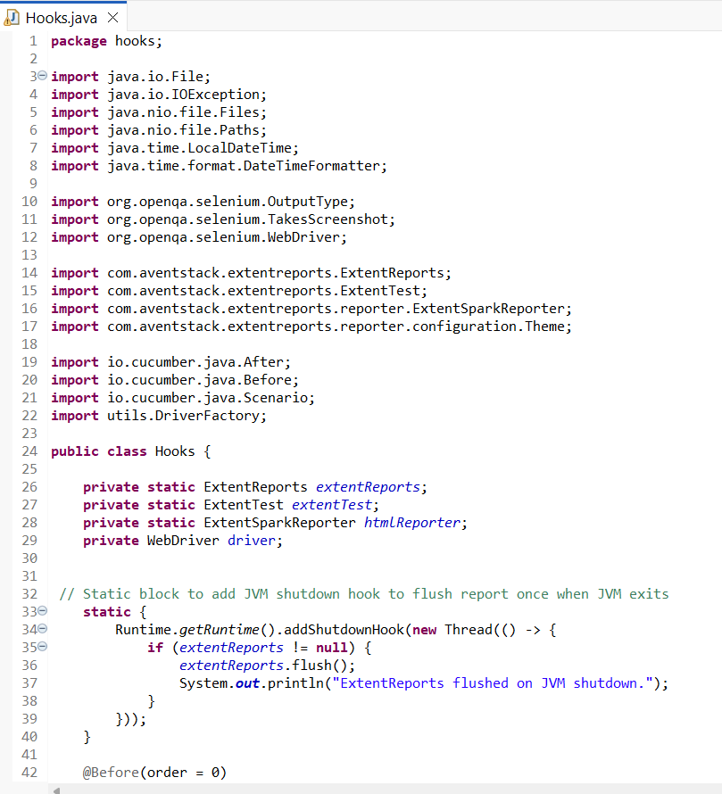
Hooks
Hooks.java
Cucumber hooks (@Before, @After) for setup and teardown (e.g., launching browser, taking screenshots on failure, closing driver).
CONFIGURATIONS
Config.properties
It keeps browser type, base URL, timeouts.
Extent.properties
It stores Extent Report settings.

Slide 16
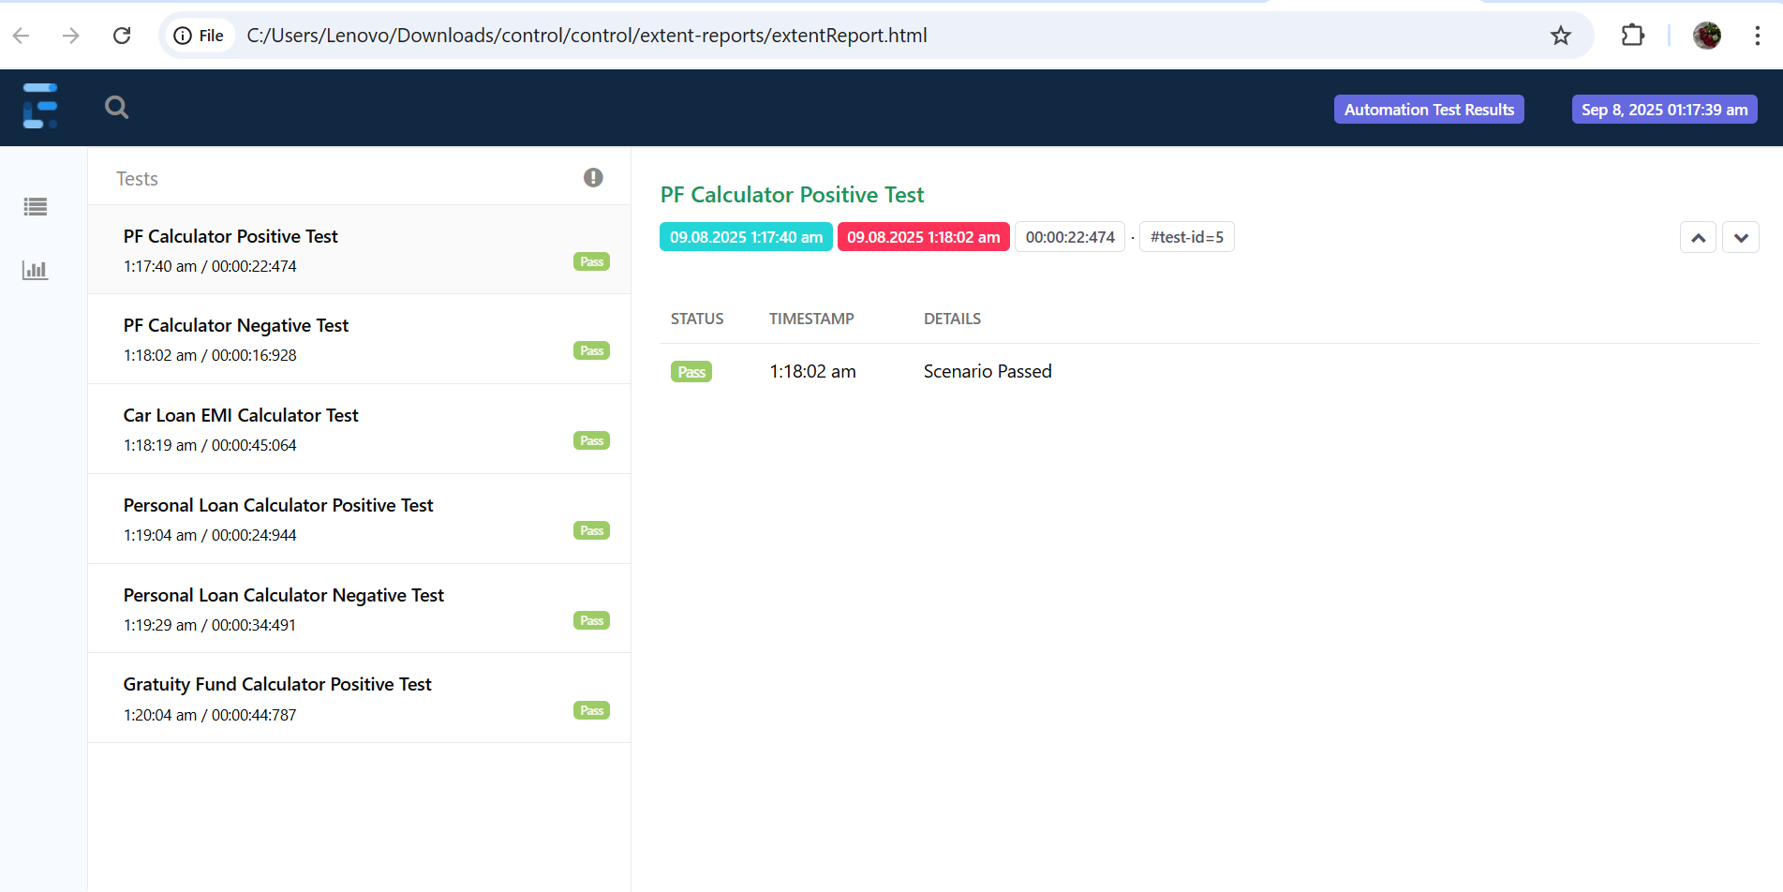
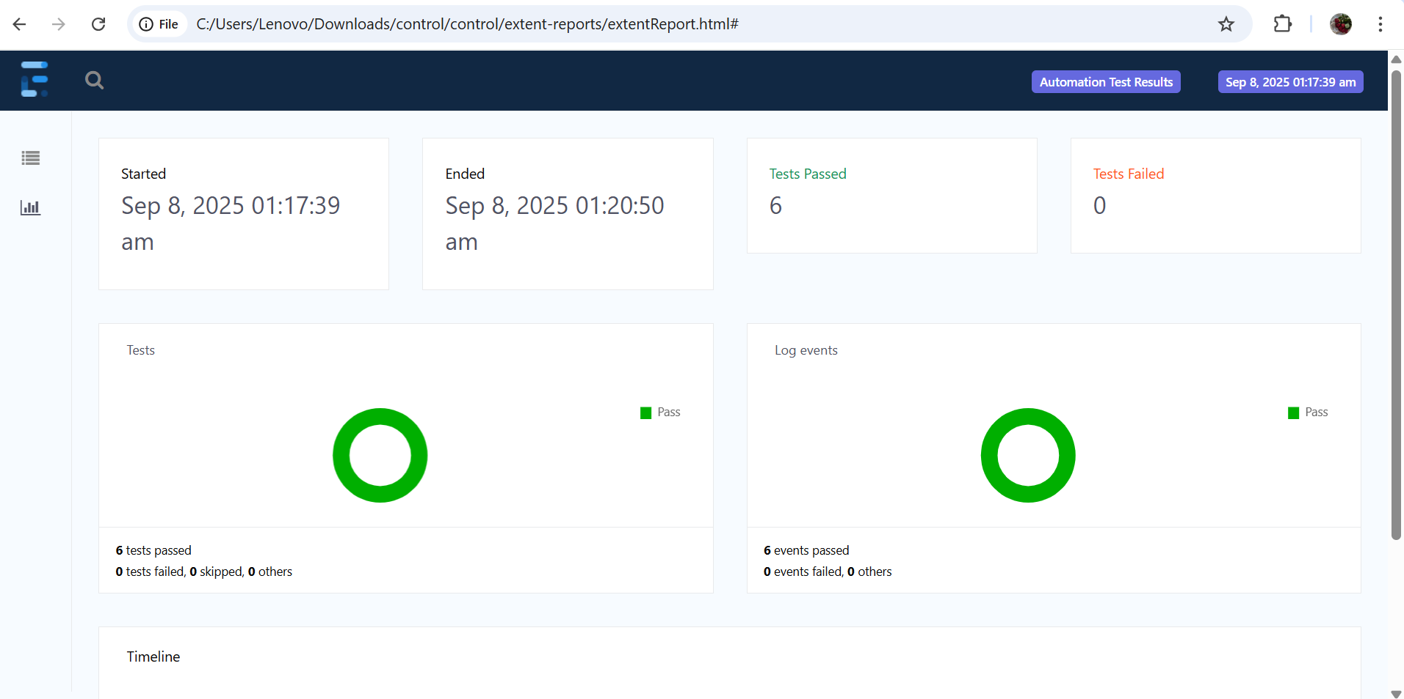
Extent Reports
ExtentReport.html

Slide 17
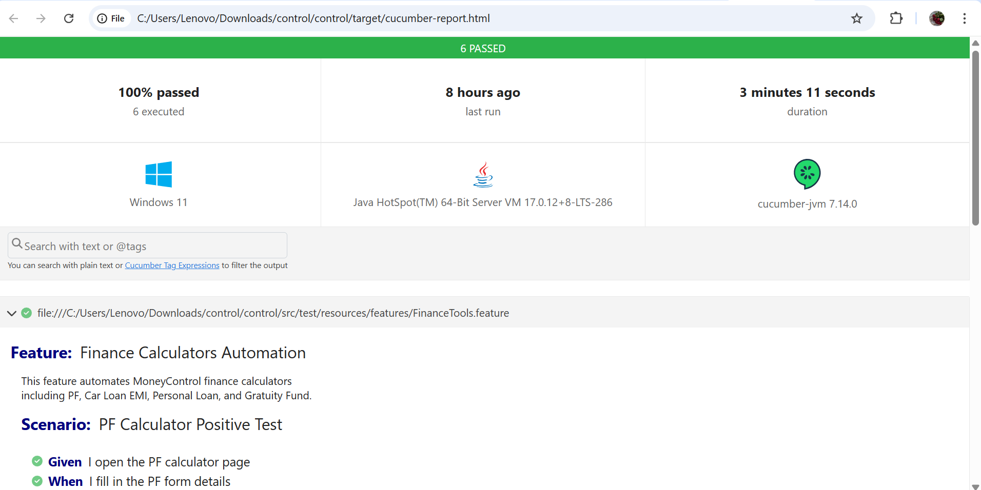
Cucumber.html

Slide 18
Project Configuration & Build Management
Testng.xml
Defines the TestNG suite, specifying which classes or packages to run..
Ensures the Cucumber TestRunner is executed for all feature files.
pom.xml
Manages project dependencies, including Selenium, Cucumber, TestNG, Apache POI, and ExtentReports.
Configures Maven plugins for build, test execution, and report generation.

Slide 19
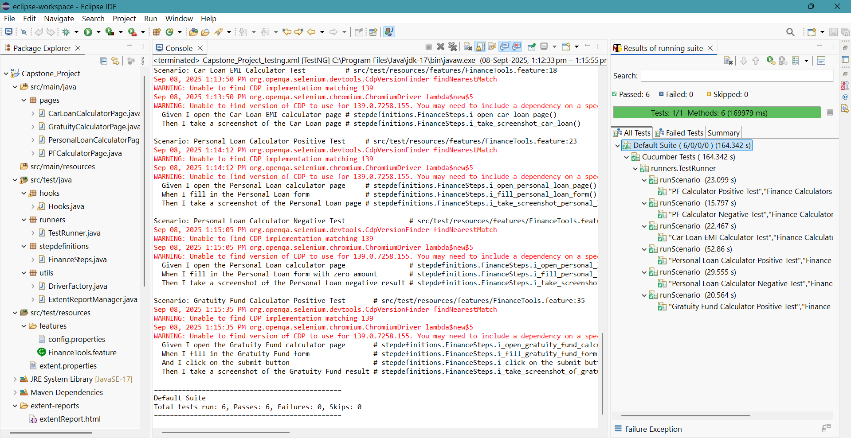
Console Output

Slide 20
GIT - Project Repository & Version Control
The complete project is hosted on GitHub for version control and collaboration.
Provides access to all feature files, POM classes, utilities, and test scripts.
Supports easy clone, pull, and push operations for updates.
Link to the repository:
🔗https://github.com/Swapnaankala/Capstone-Automation-MoneyControl_Project

Slide 21
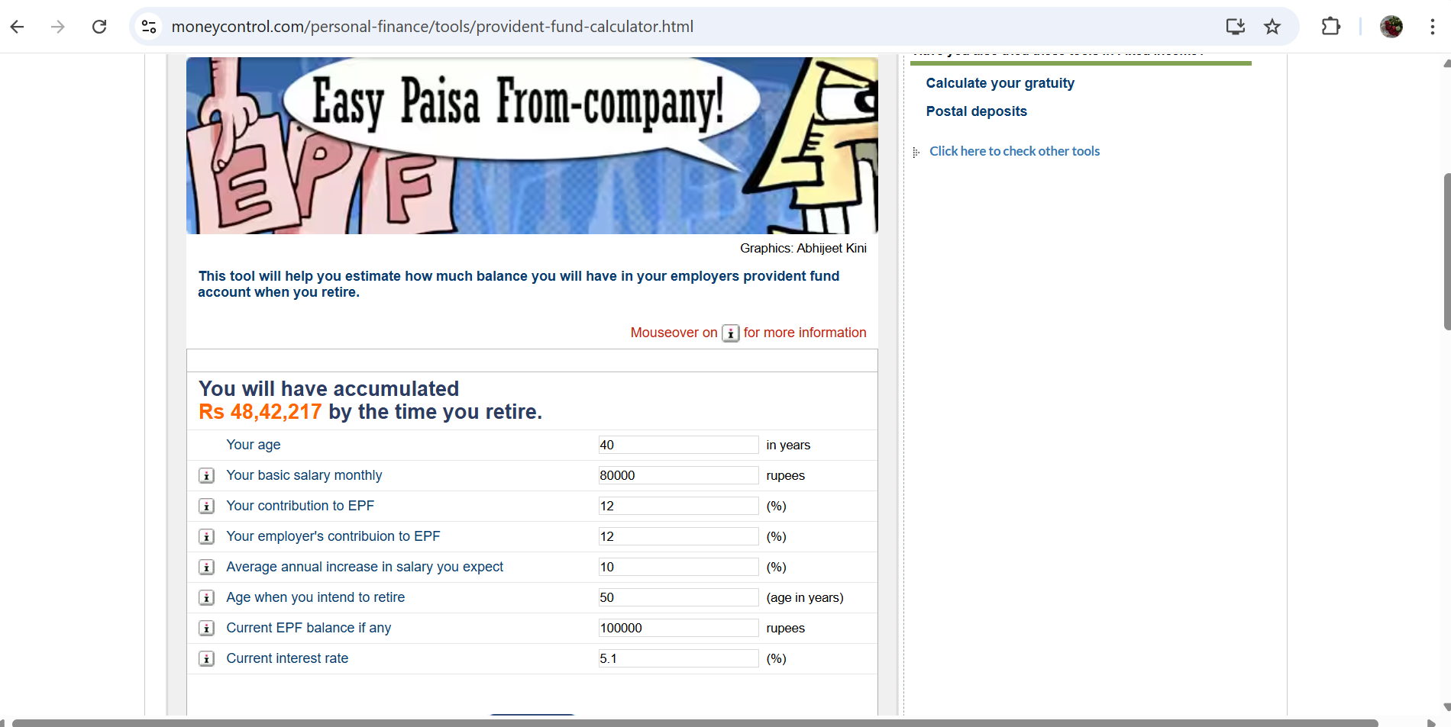
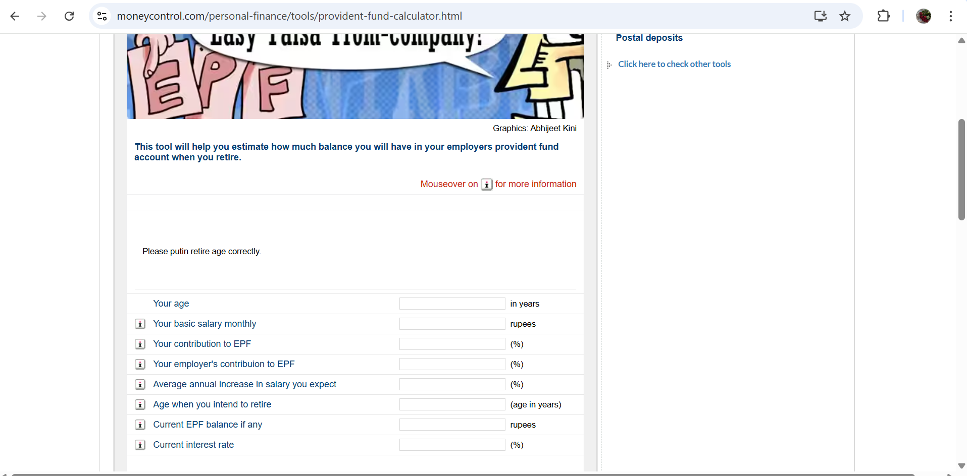
Screenshot - I
PF Calculator
Positive Testcase
Negative Testcase

Slide 22
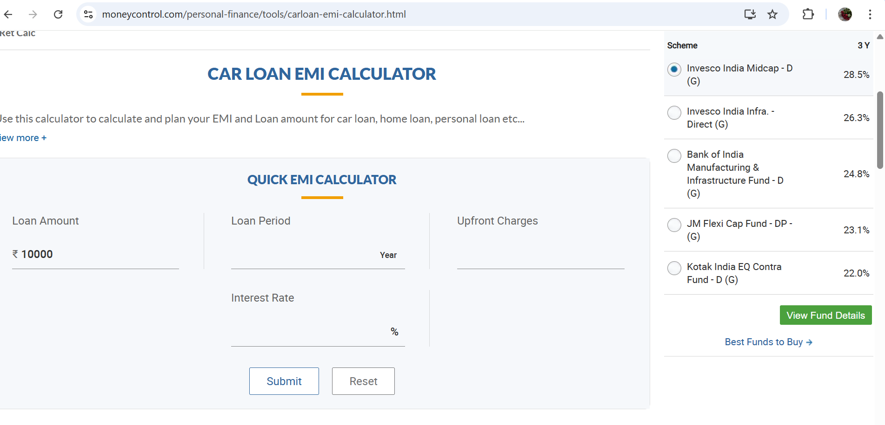
Screenshot - II
Car Loan Calculator

Slide 23
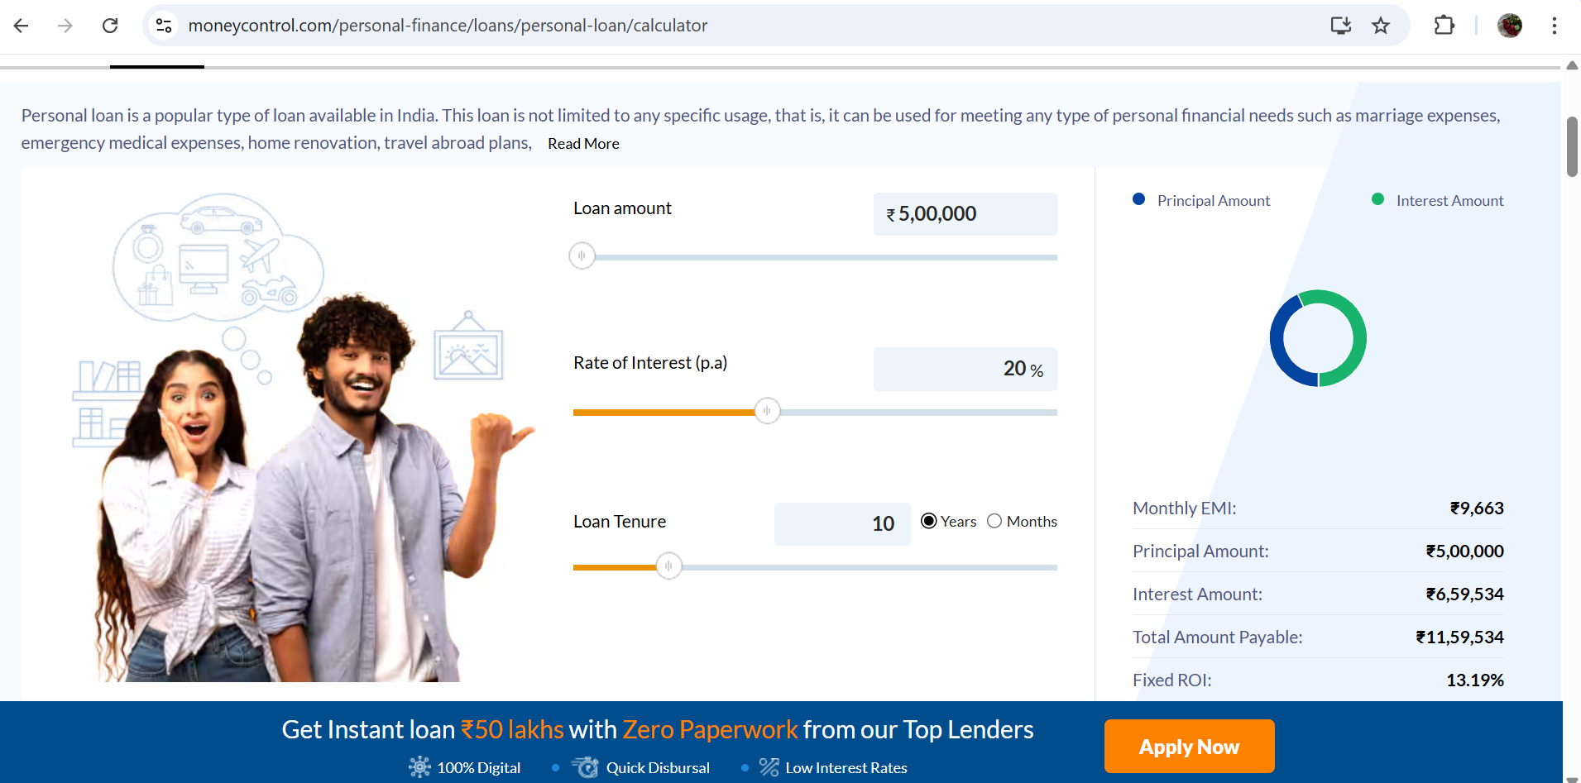
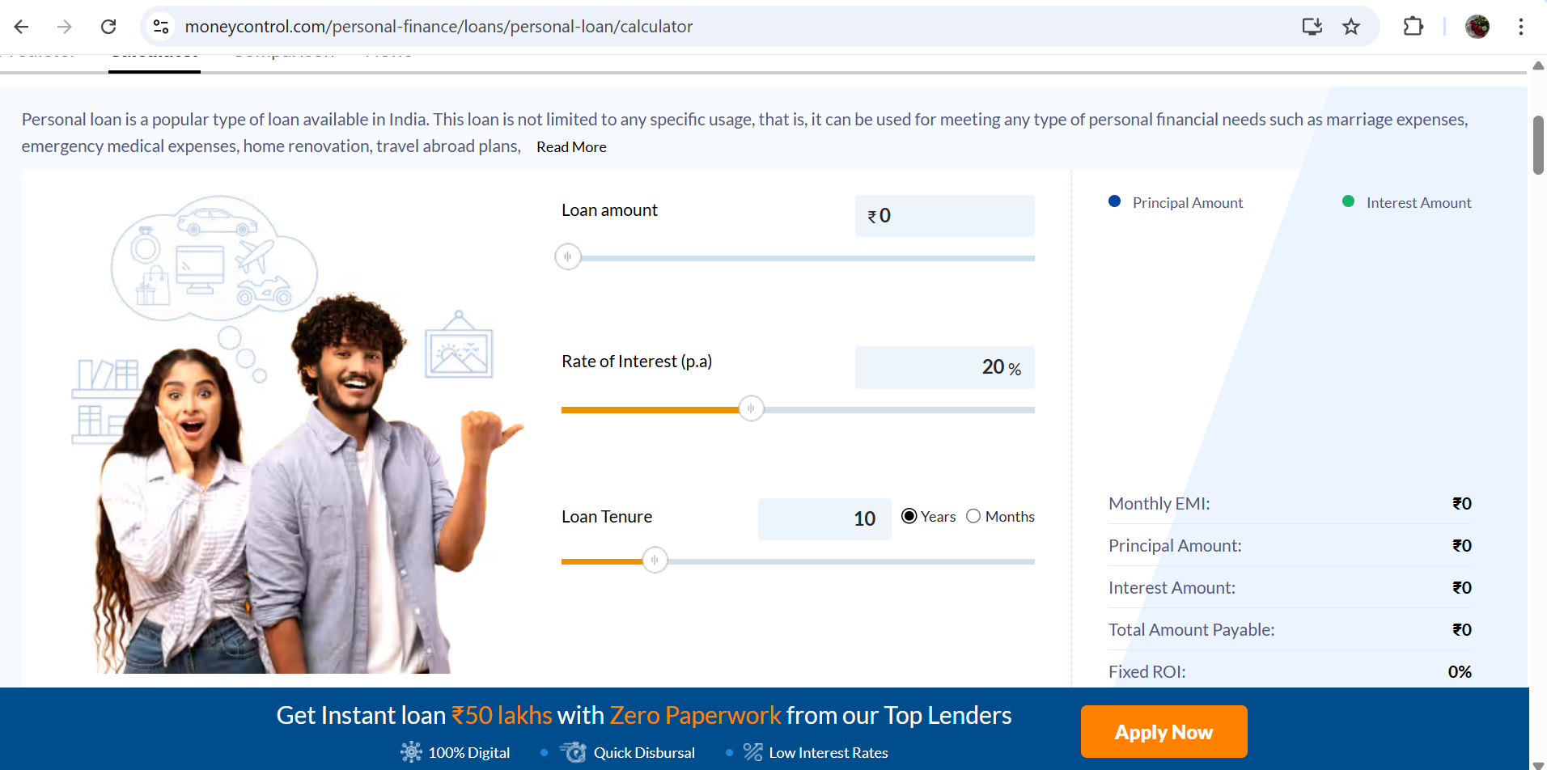
Screenshot - III
Personal Loan Calculator
Positive Testcase
Negative Testcase

Slide 24
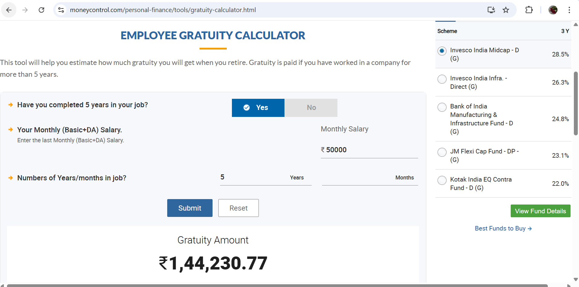
Screenshot - IV
Gratuity Fund Calculator

Slide 25
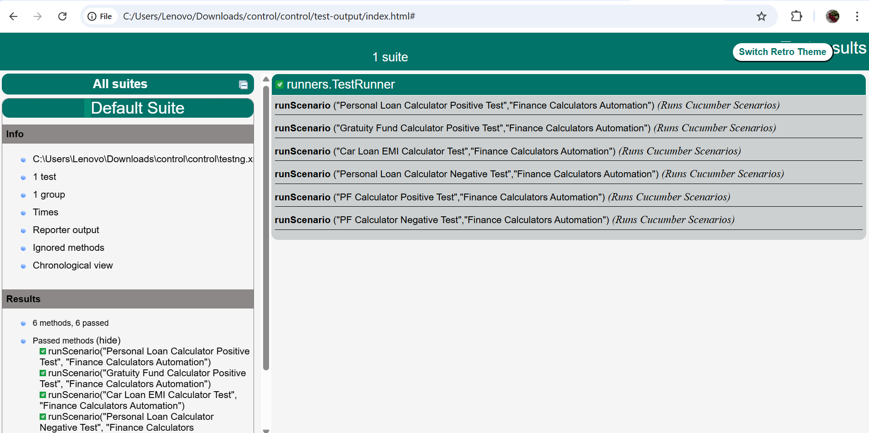
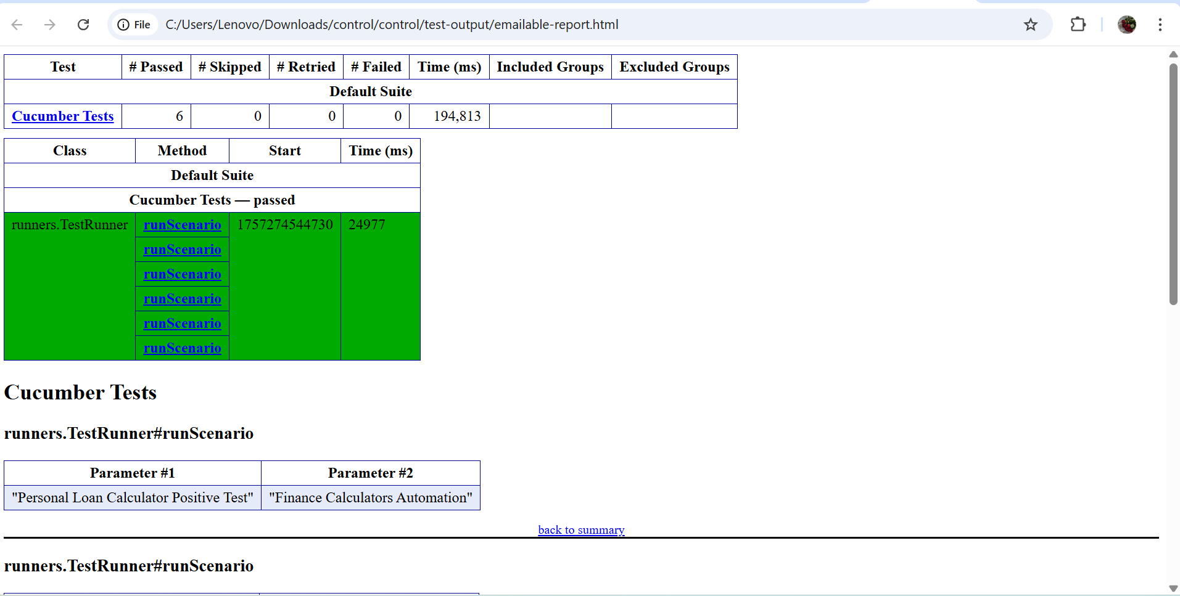
TestNG Reports.
Index.html
Emailable-report.html

Slide 26
ADD COMPANY NAME
THANK YOU

